Slide 4
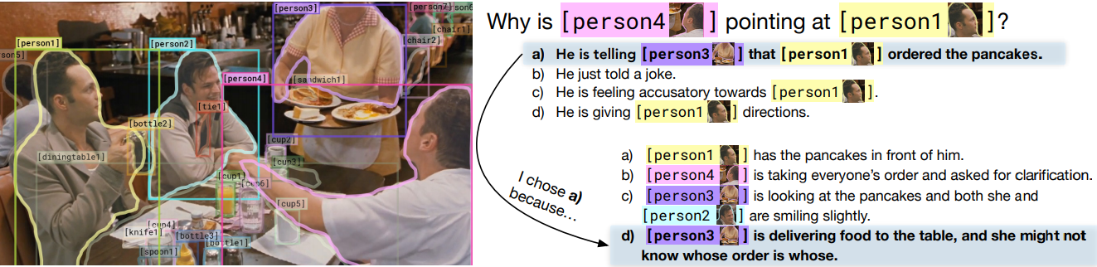
From Recognition to Cognition: Visual Commonsense Reasoning
https://arxiv.org/pdf/1811.10830.pdf
Dataset : Visual Commonsense Reasoning
Collected from Large Scale Movie Description Challenge and YouTube movie clips
List of objects (For object detection-Mask RCNN)
A query
A set of N responses

Slide 5
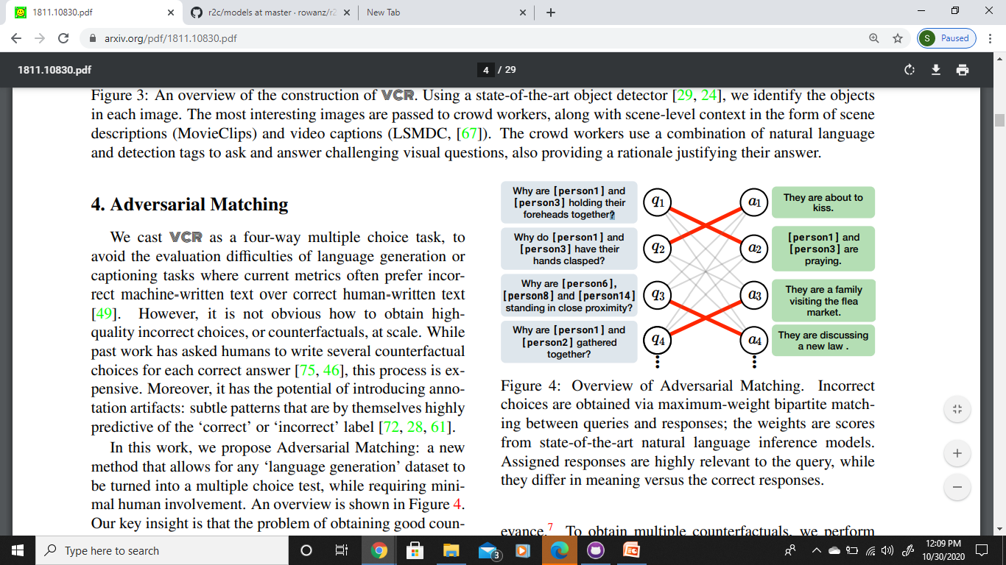
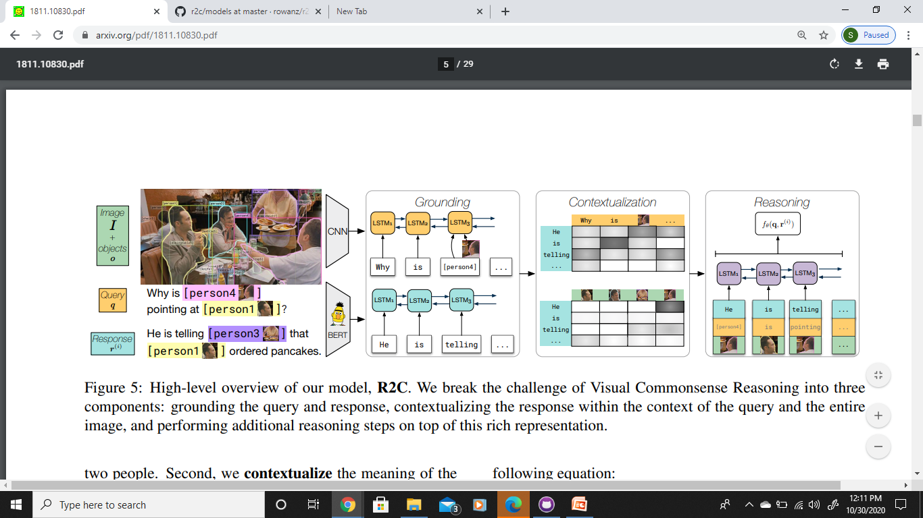
Adversarial Matching
For Question Answering Q -> A
Language generation dataset to Multiple Choice Test
Two subtasks:
- Answer is as relevant as possible(BERT)
- Dissimilarity between other answers are from the correct answer(ESIM+ELMO)
Maximum weight bipartite matching
Recognition to Cognition Model
QA -> R
Grounding
Contextualization
(Attention Model)
Reasoning

